Slide 1
Sentiment analysis on self-driving car Tweets using different NLP methods
Dharani Doppalapudi and Adam Ratzman

Slide 2
Outline
Intro
Methods
Results
Conclusion

Slide 3
Introduction
Dataset: CrowdFlower self-driving car Tweet sentiment
Why we chose it
Sentiment:
Originally, 1-5, as well as not_relevant
We converted this to 1,2,3,-1

Slide 4
Methods

Slide 5
Methods
Avoided existing sentiment analysis tools like VADER
Methods
Bag of words
Subjectivity lexicon
Bag of words with subjectivity lexicon
Dependency triples

Slide 6
Bag of words
Lemmatized words
Only kept nouns, adjectives, and verbs
Tried three combinations:
Unigrams only
Unigrams and bigrams
Unigrams, bigrams, and trigrams
TdidfVectorizer and SVC

Slide 7
MPQA Subjectivity lexicon
Used University of Pittsburgh’s MPQA subjectivity lexicon, which is a list of words with their polarity (negative, neutral, positive)
Created a ‘positivity score’ by mapping Tweets to their numbers of negative, neutral, and positive words
Used DictVectorizer and SVC

Slide 8
Bag of words with subjectivity lexicon
Combination of the bag of words approach as well as features from the subjectivity lexicon (positivity score)

Slide 9
Dependency Triples
Used MaltParser to get dependency triples (head, tail, relation) for each sentence in a tweet
We used these dependency triples to construct a feature vector

Slide 10
Results

Slide 11
One method performed badly
Just using the subjectivity lexicon performed worse than Naive Bayes or using the VADER library
Subjectivity lexicon score: 0.549
Naive Bayes: 0.550
VADER: 0.569

Slide 12
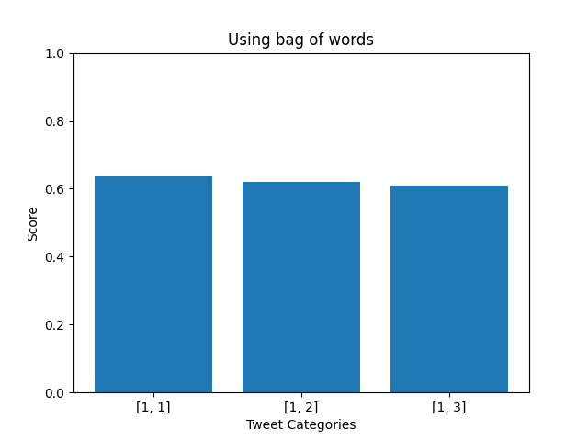
The others performed fairly well
[1,1]: 0.637
[1,2]: 0.620
[1,3]: 0.610

Slide 13
Bag of words with subjectivity lexicon and dependency triple approaches
Bag of words with subjectivity lexicon scored 0.648, the highest score of all the approaches we took
Dependency triples approach scored 0.584

Slide 14
Discussion

Slide 15
We were pleasantly surprised at our results
As beginning DS students, we were pleasantly surprised that two of our models classified almost ⅔ of tweets correctly
We were initially surprised that the subjectivity lexicon performed so poorly

